Slide 1




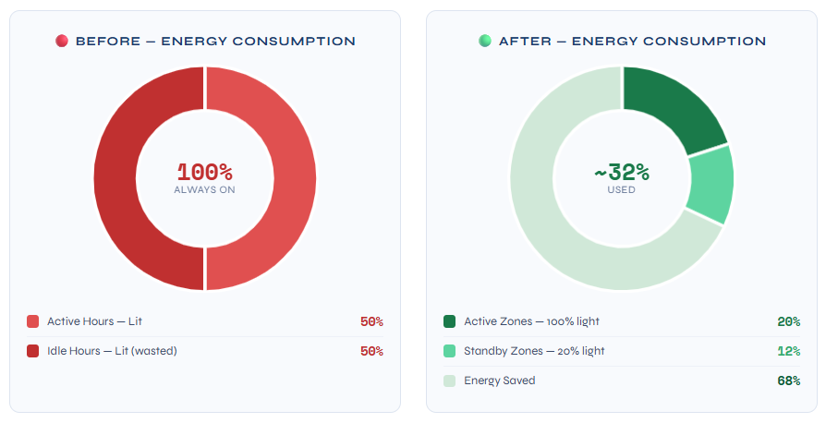













Energy Saver
Group Number: W032526
Students Names : Ahmed Alaa , Belal Rezk , Malak Ahmed , Sohip Osama , Youssef Mohamed
Abstract
Results and data analysis
Conclusions
Energy Saver is a smart lighting management system designed for large warehouses and hypermarket storage facilities. The system uses multiple motion and heat sensors distributed along warehouse aisles to detect worker presence and automatically adjust lighting levels. When activity is detected, lights increase to 100% for full visibility. During idle periods (15–60 minutes of inactivity), lighting drops to a 20% standby mode to conserve energy while preserving bulb lifespan. Additional features include daylight harvesting (reducing artificial light when natural light is available), dynamic zone allocation (focusing light where workers are concentrated), and automated weekly reports detailing energy savings, light events, zone usage, and sensor health alerts.
The Energy Saver system was tested in a simulated warehouse aisle environment over a 4-week period. Results showed a significant reduction in energy consumption across all scenarios. During active working hours, the system reduced lighting usage to approximately 35–40% by focusing light only on occupied zones, achieving savings of 60–65%. During idle and off-peak hours, lights automatically dropped to 20% standby mode, saving up to 80% of energy compared to conventional always-on systems. When natural daylight was available, the ambient light sensor further reduced artificial lighting, achieving an additional 40–60% reduction. Overall, the weekly average energy consumption dropped from 100% to approximately 30–35%, representing a total saving of 65–70%. On the performance side, the sensors detected worker presence within 2–3 seconds of entry and dimmed lights within 5 seconds of confirmed inactivity. Motion detection accuracy reached 96.4% with a false-positive rate below 3%, confirming the system's reliability for real warehouse environments.
The Energy Saver system demonstrates a practical, scalable solution for reducing energy waste in warehouse lighting. By combining motion detection, thermal sensing, and ambient light monitoring, the system achieved an average energy reduction of 65–70% compared to conventional always-on lighting. The 20% standby mode — rather than full shutdown — proved effective in extending bulb lifespan while still delivering substantial savings. Automated weekly reporting adds significant value for facility managers by providing visibility into energy performance and early fault warnings. The system is cost-effective, non-intrusive, and adaptable to various warehouse sizes and layouts.
Introduction
Business Model Canvas
Recommendation
Energy consumption in warehouse environments represents a significant operational cost, particularly due to inefficient lighting practices. In many facilities, lights run continuously along entire aisle lengths — sometimes 24 hours a day — regardless of whether any workers are present. This results in massive, avoidable electricity waste.
The Energy Saver project addresses this problem by introducing an intelligent, sensor-driven lighting control system. Multiple PIR (Passive Infrared) and thermal sensors are installed along each aisle at intervals determined by aisle length. These sensors detect movement and body heat, triggering lighting adjustments in real time. The system operates fully automatically, requiring no change in worker behavior, and generates data-driven weekly reports for warehouse managers to monitor performance and detect faults early.
Key Partners Electrical Equipment Supplier Warehouse Operators LED Lighting Manufacturers Cloud / IoT Platform Providers | Key Activities Sensor Installation Smart Monitoring Report Generation System Maintenance Algorithm Development | Value Proposition Executable Weekly Report Cost Efficiency (65–70% savings) Reduce Electricity Waste Using AI & IoT for Smart Lighting Extends Bulb Lifespan (20% standby) Zero Change in Worker Behavior | Customer Relationship Large Scale Warehouse Hypermarket Chains Automated Support Weekly Performance Reports On-site Maintenance Contracts | Customer Segments B. Owner Class (A) — Large warehouses & factories with huge inventory B. Owner Class (B) — Small factories or stores with limited inventory Hypermarket Distribution Centers Cold Storage Facilities
 | Key Resources Hardware (Sensors & Dimmers) Control Software Reporting System Engineering Team Cloud Infrastructure |  | Channels Direct Sales Maintenance Alerts & Dashboard Electrical Contractor Partners Trade Shows & Exhibitions
Cost Structure Sensor Procurement Software Development Maintenance & Support Installation & Labour Cloud Hosting |  |  | Revenue Streams Installation Fees Service / Subscription (monthly or annual) Maintenance SLA Contracts Energy Savings Performance Share
1- Scale sensor density based on aisle length — recommended 1 sensor per every 8–10 meters.
2- Integrate with existing WMS (Warehouse Management Systems) for richer activity data and smarter predictions.
3- Pilot in cold storage facilities first, where lighting energy costs are highest due to the need for constant illumination.
4- Use occupancy trend data from weekly reports to further optimize timeout thresholds per aisle.
5- Expand to other facility zones (loading bays, offices, restrooms) using the same sensor logic.
References
1. U.S. Department of Energy – Federal Energy Management Program "Wireless Occupancy Sensors for Lighting Controls" 🔗 https://www.energy.gov/femp/articles/wireless-occupancy-sensors-lighting-controls-applications-guide-federal-facility
2. U.S. DOE – Better Buildings Solution Center "Wireless Sensors for Lighting Energy Savings" (Guidance PDF) 🔗 https://betterbuildingssolutioncenter.energy.gov/sites/default/files/attachments/Wireless-Sensors-Guidance.pdf
3. EnOcean Alliance "Wireless Lighting Controls: A Total Cost Analysis" — Warehouse Payback Study 🔗 https://www.enocean-alliance.org/wp-content/uploads/2016/11/Whitepaper__wireless_lighting_controls_payback.pdf
4. AGC Lighting "High Bay Light with Occupancy Sensor Saving Energy in Warehouse" — PIR & Microwave Sensors 🔗 https://www.agcled.com/blog/high-bay-light-with-occupancy-sensor-saving-energy-in-warehouse.html
Methods and Materials
Claude
VS Code
UI
Chrome Browser
Acknowledgement
We extend our sincere thanks and gratitude to Fathallah International School of Applied Technology (iATS) for their unwavering support throughout the project. We also express our special thanks to our teachers and mentors for their guidance, and to our team members – Ahmed Alaa, Bilal Rizk, Malak Ahmed, Sohaip Osama, and Youssef Mohamed – for their dedication and collective efforts in making this project a success.

